Slide 1
Chapter 7
Sensors

Slide 2
sensors-accel
Pdf fixed

Slide 3
sensors-rate-gyro
Pdf fixed

Slide 4
sensors-absolute-pressure
Pdf fixed

Slide 5
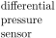
sensors-pitot-static
Pdf fixed

Slide 6
north
magnetic
north
declination
local
magnetic
field
sensors-compass
Pdf fixed

Slide 7


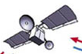


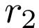
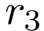
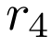
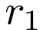

sensors-gps-sats
Pdf fixed

Slide 9

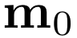
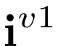


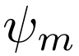
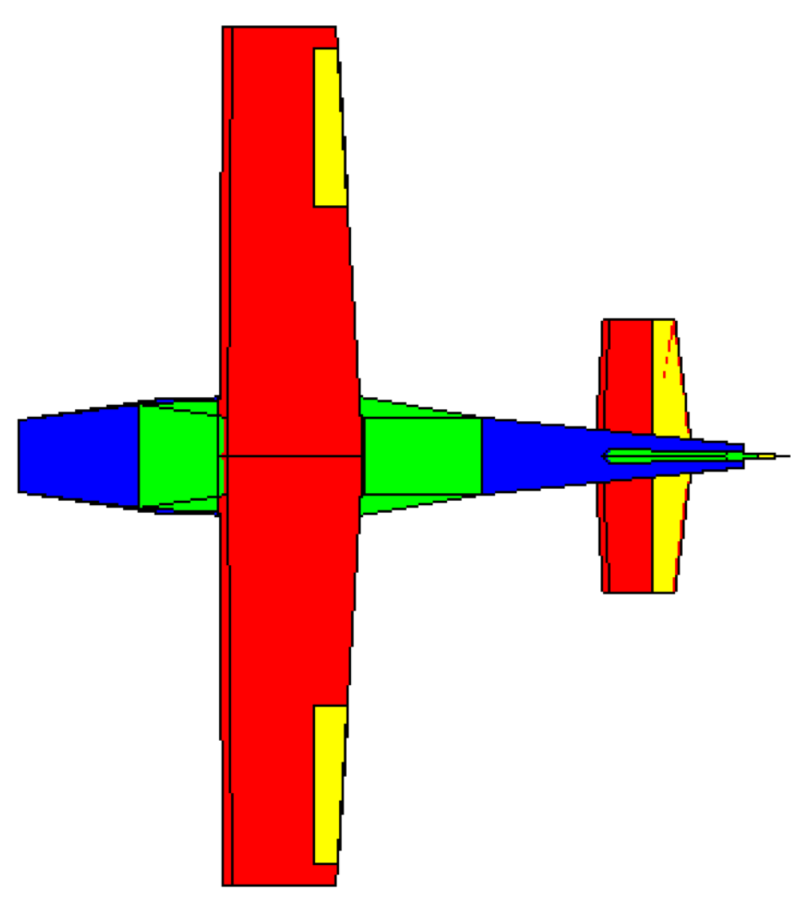
North
magnetic
North
declination
OLD
local
magnetic
field
sensors-compass
Not used

